Slide 1

TELEMEDICINE
Home About Register Patient Login

Slide 2
About Telemedicine
Telemedicine allows health care professionals to evaluate, diagnose and treat patients in remote locations using telecommunications technology. Telemedicine allows patients in remote locations to access medical expertise quickly, efficiently and without travel. Telemedicine provides more efficient use of limited expert resources who can "see" patients in multiple locations wherever they are needed without leaving their facility. In developed and developing countries telemedicine offers a reduced cost solution to delivering remote care when and where it is needed without the building and staffing added facilities. Telemedicine also reduces isolation that clinicians can experience in small medical facilities in distant locations. Telemedicine allows local practitioners to consult with their peers and with clinical experts when needed. Telemedicine further allows them to participate in grand rounds and education opportunities they would not normally have access to without travel and time away from their patients.

Slide 3
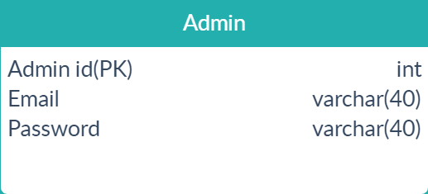
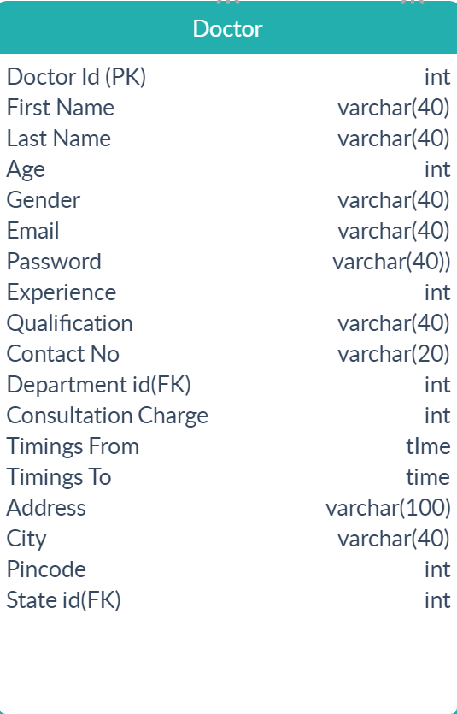
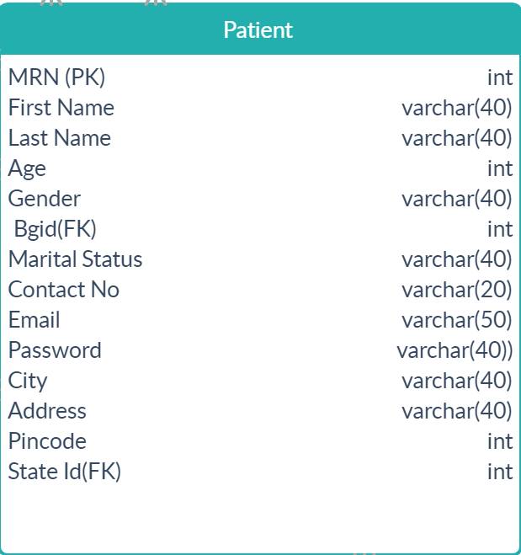
LOGIN
Email
Password
Forgot Password?
Login

Slide 4
Forgot Password
Email
Enter Email
Send

Slide 5
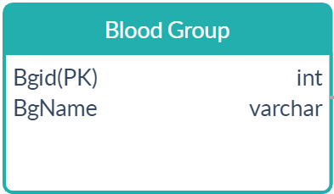
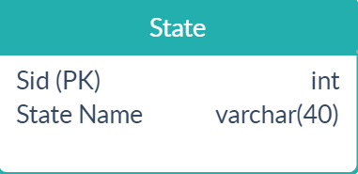

Register Patient (Home)
Auto Generated
MRN
First Name
Last Name
State
Age
City
Gender Male e Female Other
Blood Group Address
Marital Status Single Married Pin code
Email
Contact No
Password
Con Password
Home Page
Register

Slide 6
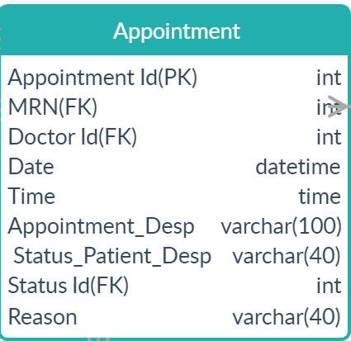

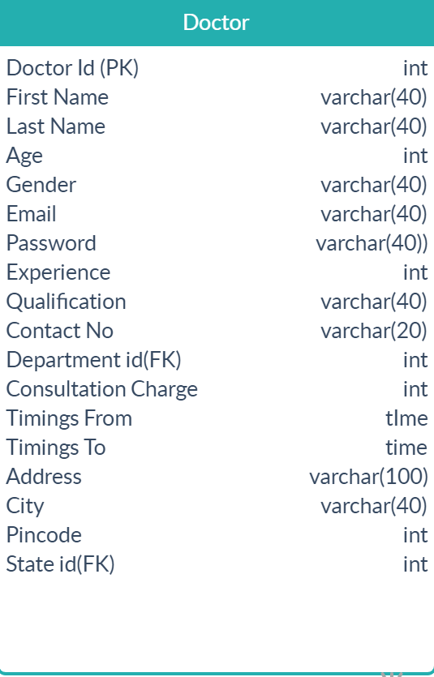
Patient Home Page
Book appointment
Update Details
View Appointments And View Prescription
Todays Appointments
Department | Doctor Name | Time
Cardiology | Dr.Ganesh | 10:10-10:20Am | Go to Consultation Room
Dentistry | Dr.Manjunath | 12:30-12:40Pm | Go to Consultation Room

Slide 7

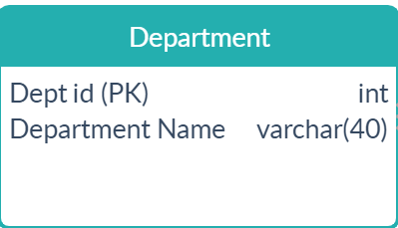
Book Appointment (Patient Home)
Department
Doctor Name
Doctor Experience
Doctor Qualification
Date
Time
Appointment Description
Consultation Charges
Home Page
10
M D
10:10 – 10:20
10:20 - 10:30
10:30 - 10:40
10:40 - 10:50
520
Book
Display doctor fee + 70% extra

Slide 8

Update Patient (Patient Home )
MRN
First Name
Last Name
State
Age
City
Gender Male Female Other
Blood Group Address
Marital Status Single Married Pin Code
Email
Contact No
Home Page
45
Save
Notes:
When user comes to this page all user details must be displayed in the text boxes.

Slide 9
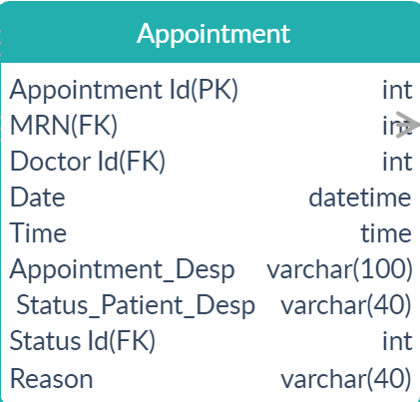

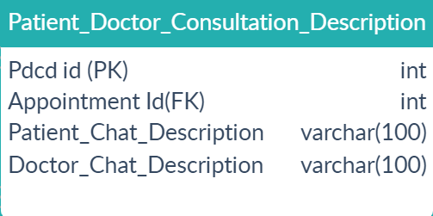
Doctor Consultation (Patient Home Page)
Doctor Name: Dept Name : Exp:
Patient Doctor Chat Window
Message
Dr.Manjunath
Cardiology
45
Patient : Hi sir
Doctor : Hello
Send
End Call

Slide 10
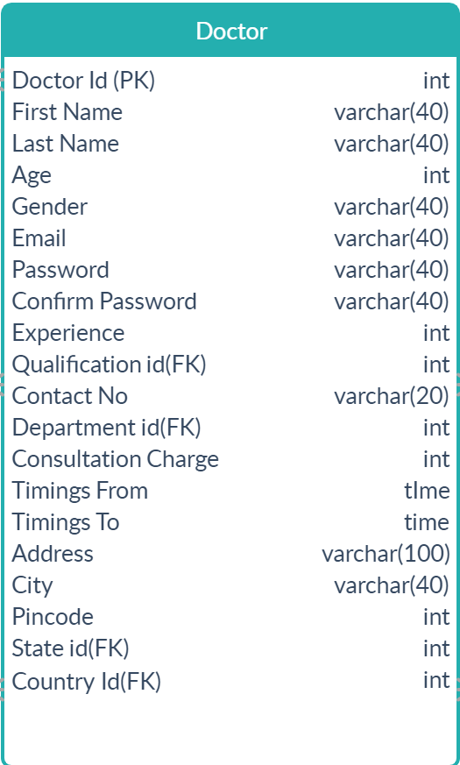
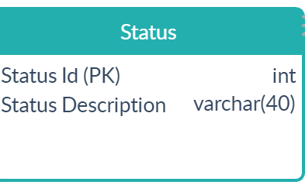
View Appointments (Patient Home Page)
Disable when appointment is approved or rejected
Department | Doctor Name | Date | Time | Status | Status Description | Reason
Cardiology | Dr.Bagirath | 08-Feb-2020 | 10:10-10:20Am | Completed | Approved | Welcome | View Prescription | Ask Questions | View Queries
Dentistry | Dr.Manjunath | 15-Feb-2020 | 12:30-12:40Pm | Upcoming | Approved | Welcome | View Prescription | Ask Questions | View Queries
Neurology | Dr.Harish | 19-Feb-2020 | 11:10-11:20Am | Upcoming | Rejected | Due to some issue | View Prescription | Ask Questions | View Queries
ENT | Dr.Mahesh | 21-Feb-2020 | 6pm | Upcoming | Waiting |  | View Prescription | Ask Questions | View Queries
Cancel
Cancel
Cancel
Cancel
Goes to View
Prescription
Enable when appointment is not approved or rejected.
Home Page

Slide 11
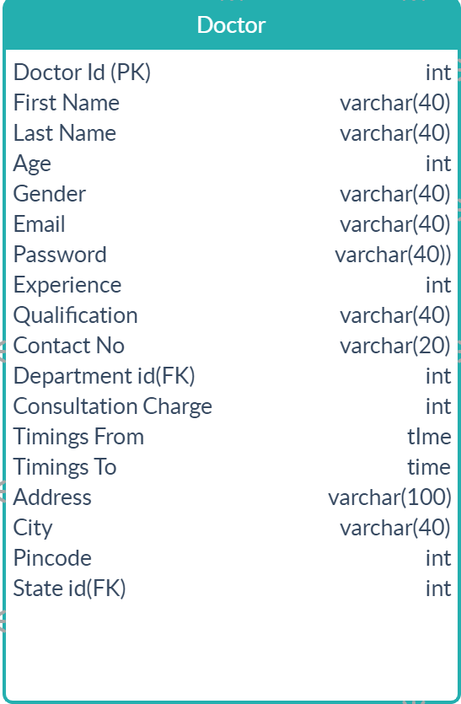
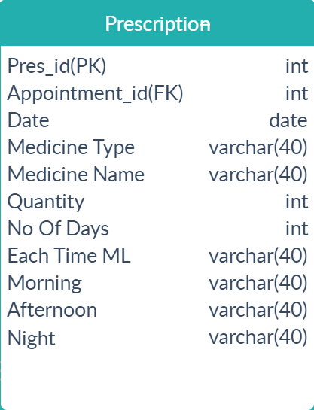
View Prescription (Patient Home -View Appointments)
Prescription Suggested By
Doctor Name:
Dr . Harish
Date
02-Feb-2020
Time:
11:00Am
Medicine Type | Medicine Name | Qty | No Of Days | Each Time ML | Morning | Afternoon | Night
Tablet | Cold act | 4 | 2 |  | After Break Fast |  | After Dinner
Tablet | Rantac | 9 | 3 |  | Before Break Fast | Before Lunch | Before Dinner
Syrup | Benadryl | 1 | 3 | 3ML |  |  | After Dinner
Table | Dolo 650 | 4 | 2 |  |  | After Lunch | After Dinner
Home Page

Slide 12
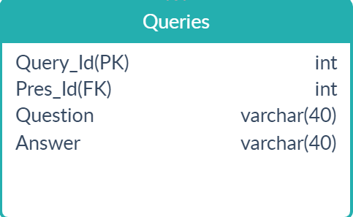
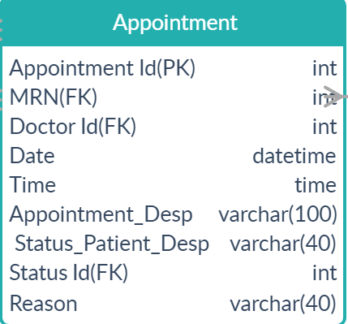
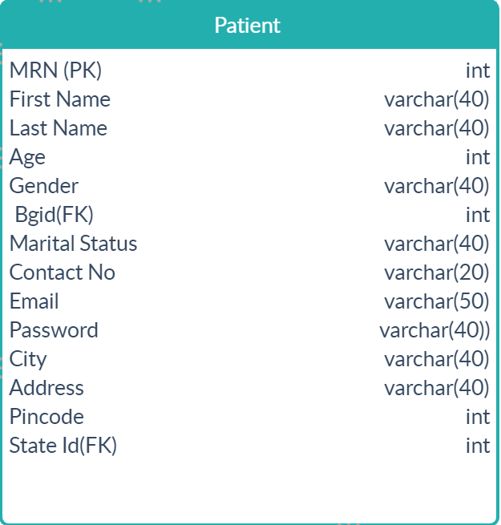
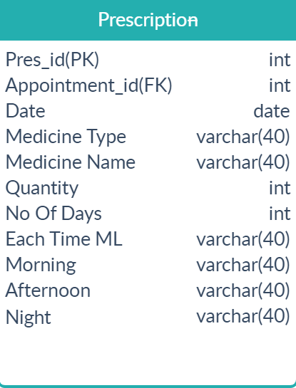
Ask Queries/Questions (Patient Home)
Patient Name
Blood Group
Age
Question
Raju
A+ve
55
Message
Send
View Appointments
Home Page

Slide 13
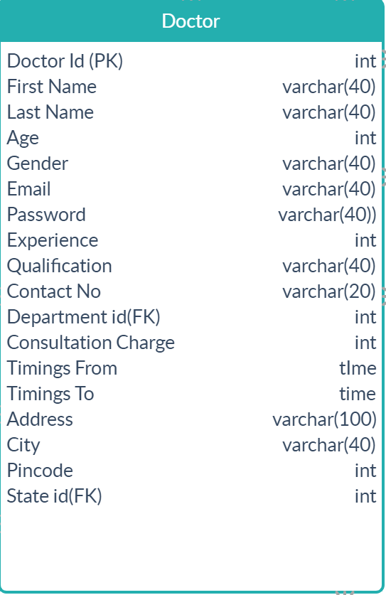
View Queries (Patient Home)
Doctor Name | Department | Experience | Question | Answer
Dr. Bagirath | Cardiologist | 25 | Regarding prescription | Don’t take medicine today on words
View Appointments
Home Page

Slide 14
Admin Home Page
Register Doctor
Edit/View Doctors
Approve/Reject Appointment
View Patients
View Doctor Leaves

Slide 15
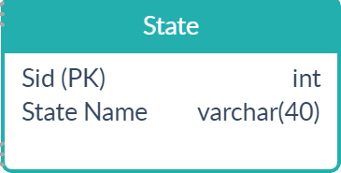
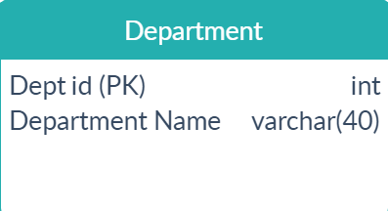
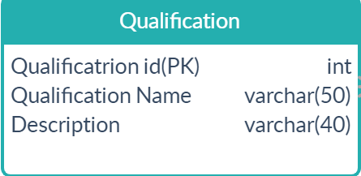
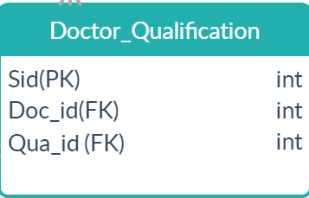

Register Doctor (Admin Home)
Auto generated
Doctor Id
First Name Department
Last Name
Age State
Gender Male Female Other City
Email
Password Address
Con Password Pin code
Experience Consultation Charges/Patient
Qualification Timings From
Contact No Timings To
12
2
List Box Multi Selection
Register
Home Page

Slide 16
View Doctors (Admin Home)
All Doctor Details
Doctor Name | Age | Gender | Dept Name | Exp | Qualifi- cation | Email | Ph No
Dr Bagirath | 56 | Male | Cardiology | 10 | M.D | bagirath@gmail.com | 9897964144 | Edit | Delete
Dr.Subramani | 60 | Male | Neurology | 12 | M B B S | Subramani12@gmail.com | 9655978855 | Edit | Delete
Dr.Rathna | 45 | Female | Dental | 6 | M S | Rathana@gmail.com | 9894596656 | Edit | Delete
Home Page

Slide 17

Update Doctor (Admin Home)
Doctor Id
First name
Email
Last Name
Age State
City
Gender Male Female Other
Address
Department
Pin code
Experience Consultation Charge/Patient
Qualification
Timings From
Contact No Timings To
Search
List Box Multi Selection
Update
Home Page

Slide 18
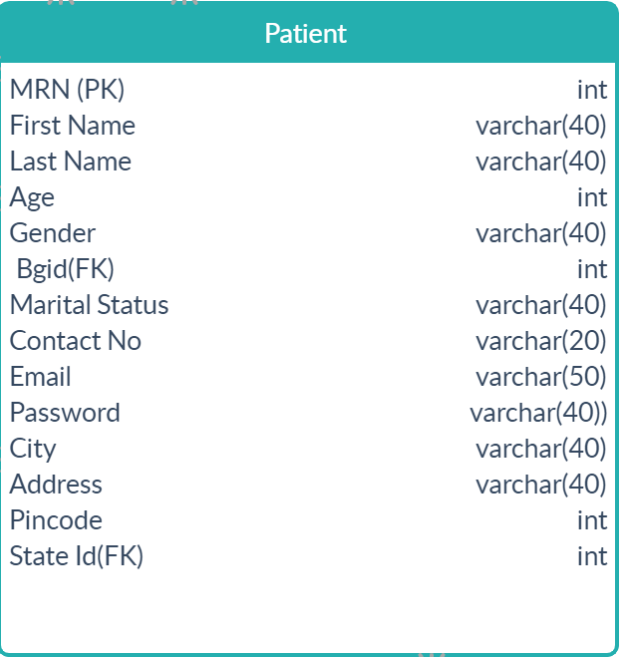
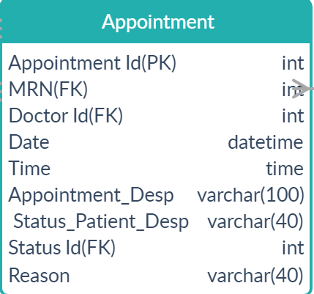
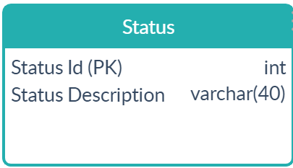
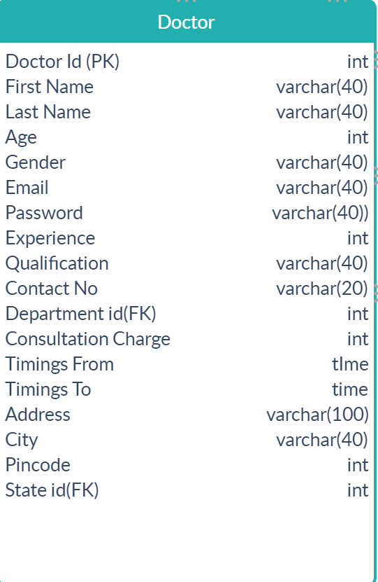
Approve / Reject appointment (Admin Home)
Patient Name | Dept Name | Doctor Name | Date | Time | Patient Status | Status description | Reason
Raj | Cardiology | Dr.Manjunath | 02-May-2020 | 10:00-10:10 Am | Requested By Patient | Approved Reject
Yogesh | Neurology | Dr.Kumar | 03-Mar-2020 | 10:30 -10:40 Am | Canceled By Patient | Approved Reject
Approved
Submit
Some Reason
Submit
When the patient canceled the request above controls are disabled
Home Page

Slide 19
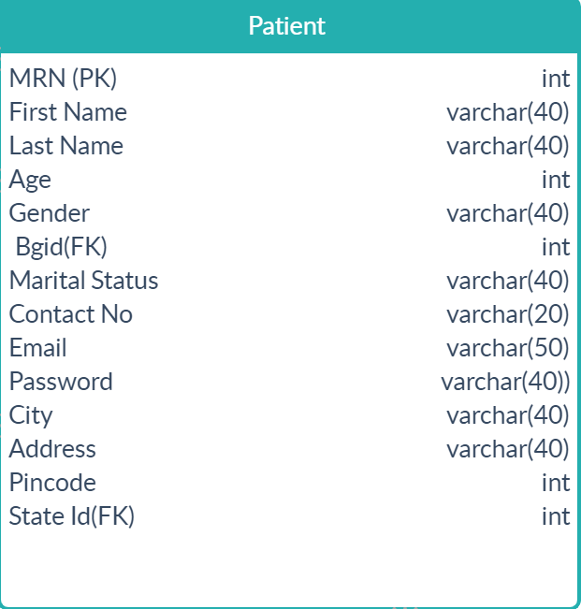
View Patients (Admin Home) All Patient Details
MRN
Search
MRN | Patient Name | Age | Gender | Blood Group | Email | Contact No
1 | Mahesh | 55 | Male | O+ve | mahesh@gmail.com | 9889559664
2 | Varun | 65 | Male | O–ve | varun@gmail.com | 9778965654
3 | Pawan | 52 | Male | A+ve | pawan@gmail.com | 6365688655
4 | Girish | 45 | Mali | B-ve | girish@gmail.com | 7487475566
1
2
3
Home Page

Slide 20
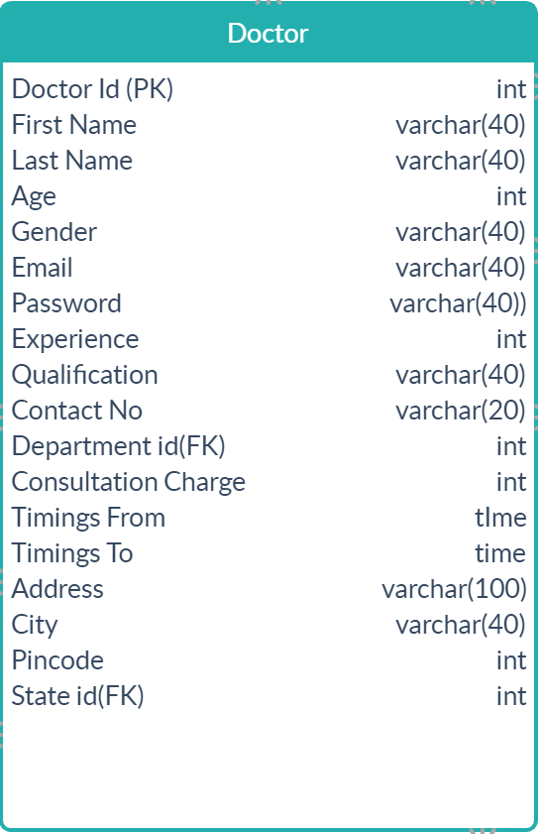
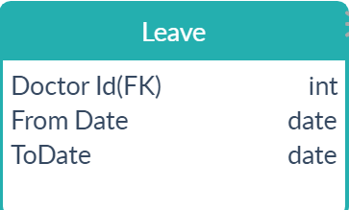
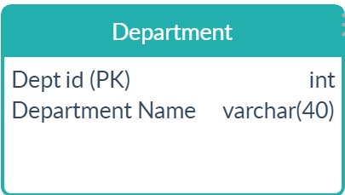
View Doctors Leave (Admin Home)
Doctor Id | Doctor Name | Department | From Date | To Date
65 | Dr.Bagirath | Cardiology | 20-Feb-2020 | 22-Feb-2020
32 | Dr.Malik | Dentistry | 25-Feb-2020 | 26-Feb-2020
36 | Dr.Manjunath | Neurology | 03-Mar-2020 | 04-Mar-2020
50 | Dr.Jyothi | ENT | 26-Feb-2020 | 26-Feb-2020
Home Page

Slide 21
Doctor Home Page
View Appointments
View Queries
Add & Edit Leave

Slide 22
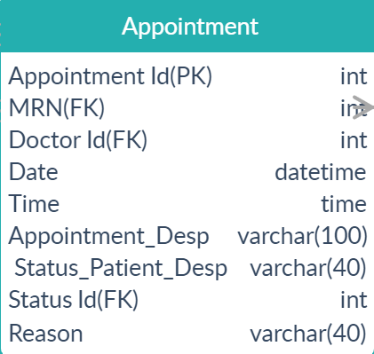
View Appointments (Doctor Home)
Home Page
View Appointments Today Tomorrow This Week
This Month Last Month
Today Appointment
MRN | Patient Name | Date | Time
12 | Lokesh | 12-Feb-2020 | 11:00-11:10 Am | Consultation Room
15 | Girish | 11-Feb-2020 | 1:00 - 1:10 Pm | Consultation Room
From Date
To Date
Search
MRN | Patient Name | Date | Time
22 | Lokesh | 12-Feb-2020 | 11:00-11:10 Am | Consultation Room
23 | Girish | 11-Feb-2020 | 1:00 - 1:10 Pm | Consultation Room

Slide 23
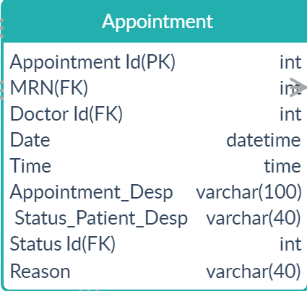
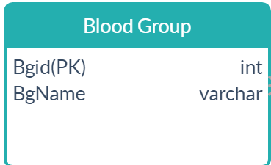
Consultation Room (Doctor Home)
Patient Name: Blood Group : Age:
Doctor Patient Chat Window
Sagar
O+ve
65
Doctor :Hi
Patient : Hello sir
Message
End Call
Generate Prescription
Send
End Call
Goes to Generate Prescript-ion

Slide 24
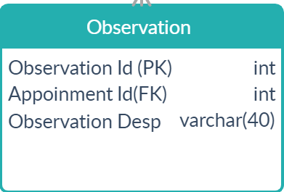
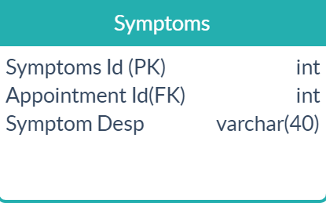
Continue Consultation Room (Doctor Home)
Symptoms Patient Symptoms
Observation
Cold
Fever
Headache
Caugh
Cold
Fever
Add Symptom
Add Observation
Observation 1
Observation 2
Observation 3
Observation 4
SAVE

Slide 25
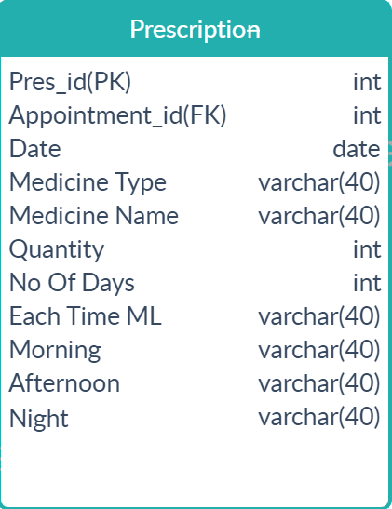
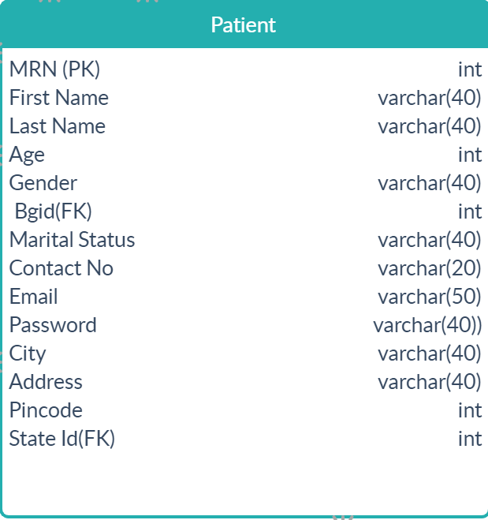
Generate Prescription (Doctor Home)
Date,Pname,BgName Disabled
Medicine Type Tablet Syrup Syringe
Medicine Name Date
Quantity Patient Name
No Of Days Blood Group
Each Time ML 3ML 5ML
Morning Before Break Fast After Break Fast
After Noon Before Lunch After Lunch
Night Before Dinner After Dinner
20-Feb-2020
Sagar
O+ve
Save medicine
Home Page
Save to db
Medicine Type | Medicine Name | Qty | No Of Days | Each Time ML | Morning | Afternoon | Night
Tablet | Cold act | 4 | 2 |  | After Break Fast |  | After Dinner
Syrup | Benadryl | 1 | 3 | 3 ML | After Break Fast | After Lunch | After Dinner
1

Slide 26
Continue Generate Prescription (Doctor Home)
Symptom Id | Symptom
1 | Cold
2 | Fever
Observation Id | Observation
1 | Tablet
2 | Syrup
This view should be top of the Generate Prescription

Slide 27
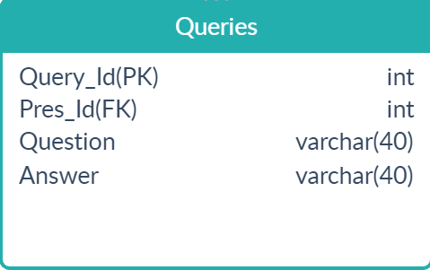
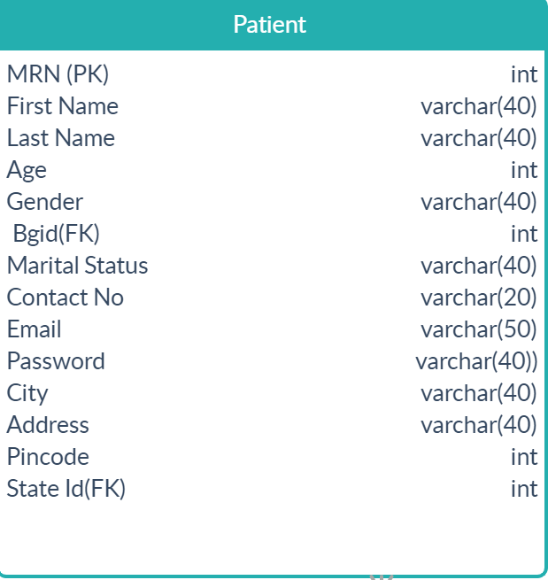
View Queries (Doctor Home)
Patient Name | Blood Group | Age | Question | Answer
Suresh | A+ve | 48 | Some Text
Manjunath | O+ve | 36 | Some query
Srikanth | B-ve | 50 | Some query
Message
Replay
Ignore
Message
Replay
Ignore
Message
Replay
Ignore

Slide 28
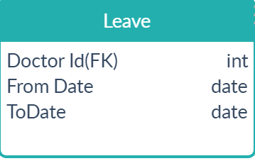
Add & Edit Leave (Doctor Home)
From Date
To Date
Submit
Disabled based on the
system date
From Date | To Date
02-Feb-2020 | 03-Feb-2020
20-Feb-2020 | 22-Feb-2020
03-Mar-2020 | 05-Mar-2020
15-Mar-2020 | 16-Mar-2020
Edit
Edit
Edit
Edit
Home Page

Slide 29
Thank You

